Slide 1
Engineering Management
Managing Engineering Design
Part 2
Lecture 28,29,30

Slide 2
Control systems in design
In creating a complex system, hundreds or thousands of engineers, technicians, and other workers may be involved in creating designs, reviewing them, manufacturing or constructing in accordance with them, or inspecting to assure that what has been made agrees with what was specified.
Drawing/Design release
Configuration management

Slide 3
Management audit of the design function
Product Liability
Reducing Liability.

Slide 4


History
Lawrence D.Miles
1904 - 1985
Shortage of materials during world war II
General Electric company found that many of the substitutes
have better or equal performance at less cost.
Lawrence De Miles Launched an effort to make the concept systematic
Establishment of Society of American Value Engineers “SAVE” in 1959

Slide 5


What is Value?
Value is the lowest price you must pay to provide a reliable
function or service (L. D. Miles)
“The ratio of Function to Cost”
Worth Function(Utility)
Value =
=
Cost Cost

Slide 6


Waste Cost
Why do Projects have “Unnecessary” Costs?
Low Time for Designing
Lack of information
Lack of Ideas
Negative Prejudice
Lack Of Experience
Weaknesses in human relations
Multi Concept

Slide 7
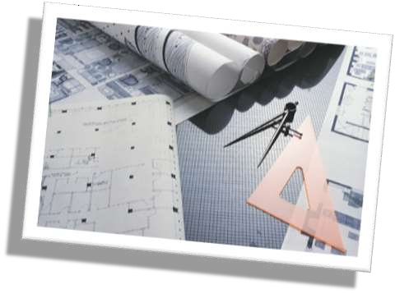
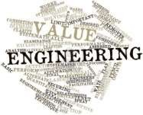


What is Value Engineering?

Slide 8
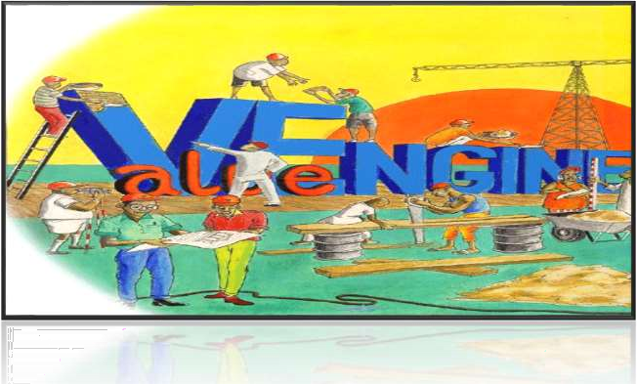
What is Value Engineering?
Value engineering is a systematic, organized approach to provide necessary functions in a project at the lowest cost. Value engineering promotes the substitution of materials and methods with less expensive alternatives, without sacrificing functionality. It is focused solely on the functions of various components and materials, rather than their physical attributes.

Slide 9

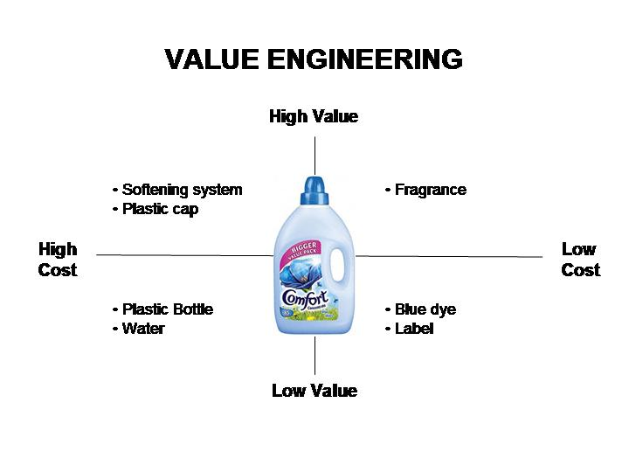
Implementation example

Slide 10
Value Engineering
Lecture 28,29,30 Part 2

Slide 11

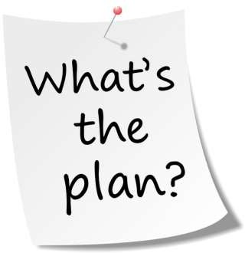
The Job Plan
Value engineering is often done by systematically following
a multi-stage job plan. Larry Miles' original system was a six-step procedure which he called the "value analysis job plan."

Slide 12
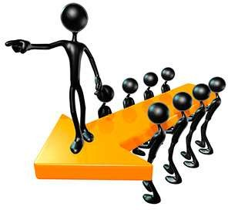
The Job Plan
The modern version has the following eight steps:
Orientation
Information
Functional
Creative
Evaluation
Development
Presentation
Implementation and Follow-up

Slide 13

The Job Plan
Orientation Phase
  Identify issues
  Prioritize Issues
  Drafts scopes and objective
  Establish evaluation factors
  Determine Study Team
  Collect Data
  Prepare for value study
  ...

Slide 14

The Job Plan
2. Information Phase
Further familiarization of the project by the team; all team members participate in determine the true needs of the project.
Areas of high cost or low worth are identified.

Slide 15
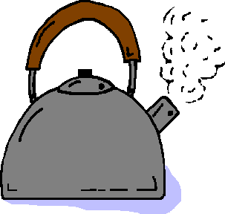
The Job Plan
3. Functional Phase
Functional analysis outlines the basic function of a product using a verb and a noun such as ‘boil water’ as in the case of our kettle.
What is the Function?
“ Boil
Verb
Water ”
Noun

Slide 16
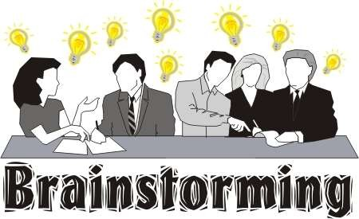
The Job Plan
4. Creative Phase
This step requires a certain amount of creative thinking by the team. A technique that is useful for this type of analysis is brainstorming. This stage is concerned with developing alternative.

Slide 17
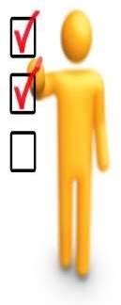
The Job Plan
5. Evaluation Phase
In this phase of the workshop, the VA team judges the ideas developed during the creative phase.
The VA team ranks the ideas.
  Ideas found to be irrelevant or not worthy of additional study are disregarded.
  Those ideas that represent the greatest potential for cost savings and improvements are selected for development.

Slide 18

The Job Plan
6. Development Phase
The team develops the selected ideas into alternatives (or proposals) with a sufficient level of documentation to allow decision makers to determine if the alternative should be implemented.

Slide 19

The Job Plan
7. Presentation Phase
1. The presentation phase is actually presenting the best alternative (or alternatives) to those who have the authority to implement the proposed solutions that are acceptable.

Slide 20
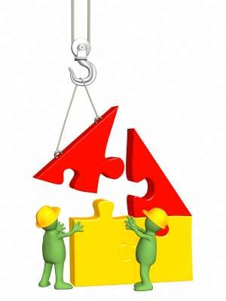
The Job Plan
8. Implementation And Follow Up
Develop an implementation plan
Execute the plan
Monitor the plan to completion
Objective: During the implementation and follow-up phase, management must assure that approved recommendations are converted into actions.

Slide 21

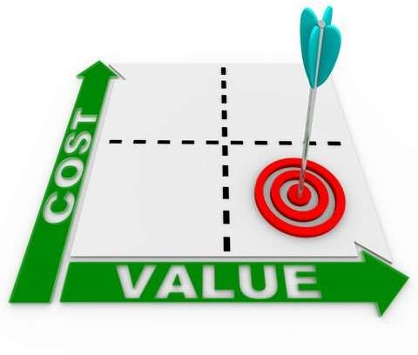
Purpose
Determine the best design alternatives
Reduce cost
Improve quality
Increase reliability and availability
Enhance customer satisfaction
Improve organizational performance
Identify problems
Develop recommended solutions

Slide 22





Principles
Value Engineering principles:
1
Systematic method for evaluating product performance and value
2
The use of multi-functional teams
3
Focus on a simplified product

Slide 23

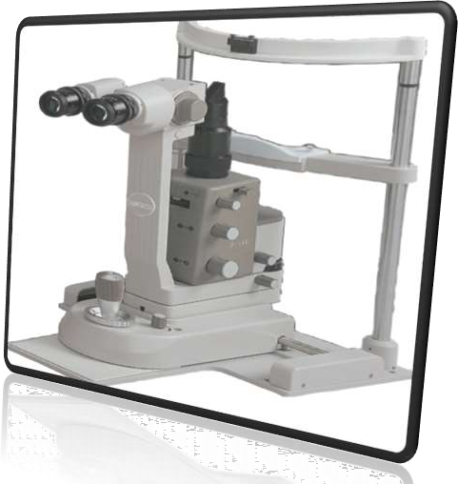

Case Study
Focus Adjustment Knob for Slit Lamp

Slide 24
Case Study
Introduce the Product
In this case study we have considered a medical instrument manufacturing company, Aadarsh Instruments, located in Ambala.
This firm is producing different types of microscopes which they export to various countries around the globe.
One of their model SL250 have a component named Focus Adjustment Knob for Slit Lamp in microscope. This microscope has found application in the field of eye inspection.

Slide 25

Case Study
The steps used for this purpose are as follows:
Product selection plan
Gather information of product
Functional analysis
Creativity Worksheet
Evaluation sheet
Cost analysis
Result

Slide 26

Case Study
1. Plan For Product Selection
This Product is used to adjust the focus of lens for magnification purpose.
The present specifications of this part and its material used are costlier than the average industry cost.
Value of this product can be increased by maintaining its functions and reducing its cost or keeping the cost constant and increasing the functionality of the product.

Slide 27
Case Study
2. Obtain Product Information
Material – Aluminum Bronze Alloy
Diameter of base plate –30 mm
Thickness of plate--3 mm
Cost of the scrap is – 293 rupee/Kg
Pieces Produced annually – 8000
Process used – C.N.C. indexing milling
Cycle time—2.5 min
Anodizing—2/min
Material cost—65 gm
Total Present cost – 29.99 rupee /piece

Slide 28
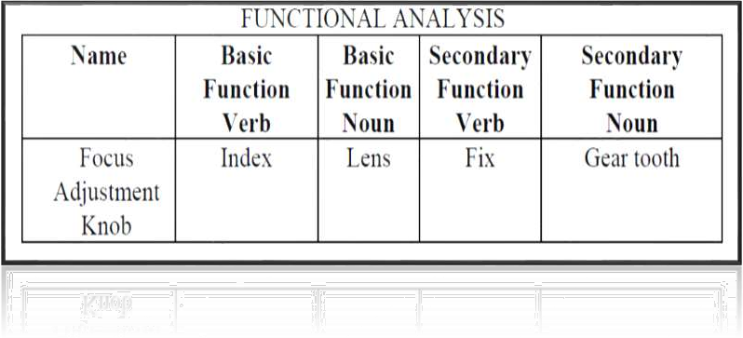
Case Study
3. Functional Analysis of Present Functions

Slide 29


Case Study
4. Develop Alternate Design Or Methods
During brainstorming these ideas were listed:
Change design
Change material
Use plastic
Make it lighter
Change the production process
Use nylon indexing unit

Slide 30

Case Study
Evaluation Phase
For judging the ideas, the following designs were considered:
  Function
  Cost
  Maintainability
  Quality
  Space
each of the above criteria was compared with others , and depending on their relative importance, three categories were formed, major, medium, and minor.

Slide 31
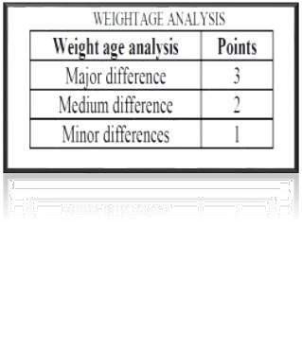
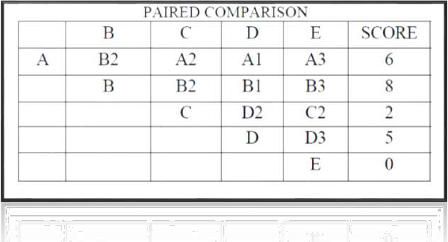
Case Study
Comparing this criteria according to relative importance :

Slide 32
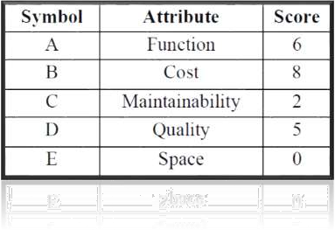
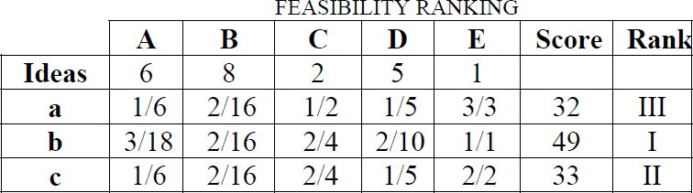
Case Study
From the paired comparison we get the following result:
The above ideas were discussed and the best feasible ideas were separated which were:
Change the material to steel
Use Nylon unit
Use existing material

Slide 33
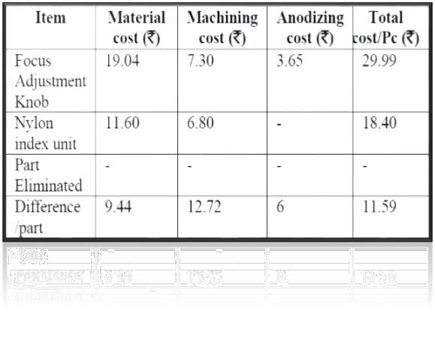

Case Study
6. Cost Analysis

Slide 34

Case Study
Result
The total savings after the implementation of value engineering are given below:
  Cost before analysis – 29.99 rupee
  Total Cost of nylon knob – 18.40 rupee
  Saving per product – 11.59 rupee
  Percentage saving per product – 38.64 %
  Annual Demand of the product – 8000
  Total Annual Saving – 92,720 rupee
  Value Improvement - 62.98 %

Slide 35



Conclusion
Three goals that we're looking at value engineering:
Identify additional functions that aren’t
attractive to customers.
Add attractive functions for customers.
Saving because of the elimination of
redundant functions.

